Slide 1
A Deep Dive into Disease Prediction using Artificial Neural Networks: Insights from Data Analysis
Anil

Slide 2
AGENDA
01
04
INTRODUCTION
RESULTS AND
DISCUSSION
02
05
LITERATURE
REVIEW
CONCLUSION
03
06
METHODOLOGY
REFERENCES

Slide 3
INTRODUCTION
DISEASE PREDICTION
Early detection
Preventive measures
Public health planning
Personalized medicine
ML AND DL Advancement
Increased accuracy
Improved data processing
Integration with other technologies
Faster identification of disease patterns
Automated disease diagnosis

Slide 4
LITERATURE REVIEW
The research[1] describes a study that used machine learning algorithms to classify skin diseases based on image features, and found that selecting the appropriate algorithm and feature extraction strategies were crucial for achieving high precision.
A study[2] compared different AI algorithms for the diagnosis of various diseases, such as heart disease, diabetes, liver disease, dengue, and hepatitis. The study found that different algorithms had varying accuracy rates and emphasized the importance of selecting the appropriate algorithm for each disease.
This study[3] discusses the use of data mining techniques for disease classification, highlighting their increased use but limited focus on developing consistent procedures

Slide 5
METHODOLOGY
01
EDA
Data preprocessing and exploratory data analysis was performed
MODEL BUILDING
02
ANN Model was carefully built
03
TRAINING
Model was trained for certain epochs
HYPERPARAMETER TUNING
04
Best set of hyperparameters were choosen
05
TESTING
The ANN model was tested on the test dataset
RESULT ANALYSIS
06
The results were analysed for insights
07
COMPARATIVE ANALYSIS
Model’s performance was compared with other models

Slide 6
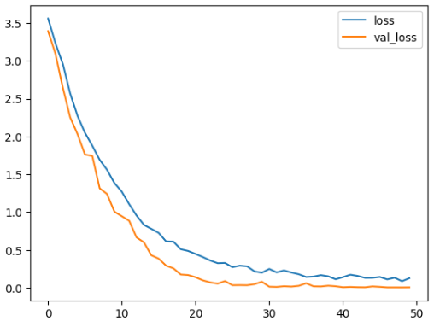
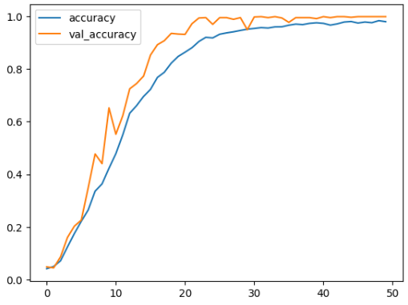
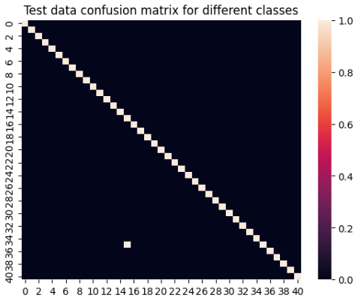
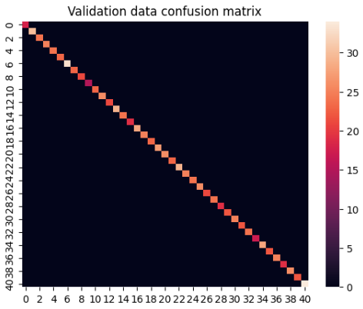
Results (Continued…)
Very good accuracy of 99.87% was achieved after proper hyperparameter tuning
Other model also performed well but ANN out-performed them
Figure 1: Losses plot
Figure 2: Accuracy Plot
Figure 3: Confusion matrix on test data
Figure 4: Confusion matrix on Validation data

Slide 7
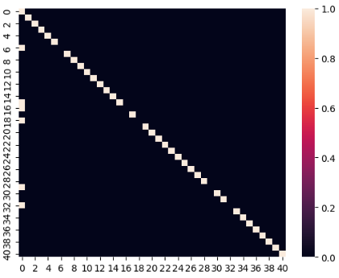
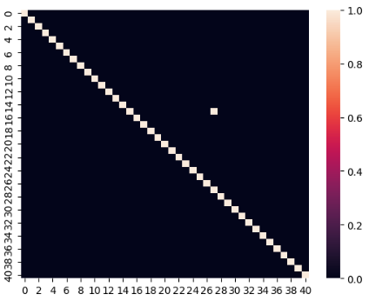
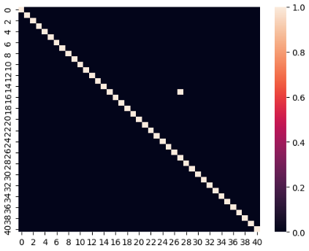
Results (Continued…)
Figure 5: Random Forest
Figure 13: Logistic Regression
Figure 14: KNearest Neighbors

Slide 8
CONCLUSION
ANN model accurately predicts diseases based on symptoms.
Model design and parameters confirmed by hyperparameter tuning and comparisons with other models.
Expansion of dataset and feature selection methods can enhance performance.
Promising future for medical diagnosis and potential to save lives through early detection and treatment.
Disease prediction can support individualised healthcare approaches and improve patient outcomes.

Slide 9
REFERENCES
[1]P. R. Hegde, M. M. Shenoy, and B. H. Shekar, “Comparison of Machine Learning Algorithms for Skin Disease Classification Using Color and Texture Features,” 2018 International Conference on Advances in Computing, Communications and Informatics (ICACCI), Sep. 2018, doi: https://doi.org/10.1109/icacci.2018.8554512.
[2]M. Fatima and M. Pasha, “Survey of Machine Learning Algorithms for Disease Diagnostic,” Journal of Intelligent Learning Systems and Applications, vol. 09, no. 01, pp. 1–16, 2017, doi: https://doi.org/10.4236/jilsa.2017.91001.
[3]M. Nilashi et al., “Disease Diagnosis Using Machine Learning Techniques: A Review and Classification,” Journal of Soft Computing and Decision Support Systems, vol. 7, no. 1, pp. 19–30, Mar. 2020, Available: http://www.jscdss.com/index.php/files/article/view/224

Slide 10
THANK YOU

